Slide 1

CAPSTONE PROJECT-4
BOOK RECOMMENDATION SYSTEM
Satyam Jyoti Sankar

Slide 2
CONTENT
BUSINESS UNDERSTANDING
DATA OVERVIEW
DATA DESCRIPTION
PREPROCESS DATA
EXPLORATORY DATA ANALYSIS
RECOMMENDATION SYSTEM
CHALLENGES
CONCLUSIONS

Slide 3
BUSINESS UNDERSTANDING
During the last few decades, with the rise of Youtube, Amazon, Netflix, and many other such web services, recommender systems have taken more and more place in our lives.
From e-commerce (suggest to buyers articles that could interest them) to online advertisement (suggest to users the right contents, matching their preferences), recommender systems are today unavoidable in our daily online journeys.
In a very general way, recommender systems are algorithms aimed at suggesting relevant items to users (items being movies to watch, text to read, products to buy, or anything else depending on industries).
Recommender systems are really critical in some industries as they can generate a huge amount of income when they are efficient or also be a way to stand out significantly from competitors. The main objective is to create a book recommendation system for users.

Slide 4
DATA OVERVIEW
The Book-Crossing dataset comprises 3 files.
Contains the users. Note that user IDs (User-ID) have been anonymized and map to integers. Demographic data is provided (Location, Age) if available. Otherwise, these fields contain NULLvalues.
Books are identified by their respective ISBN. Invalid ISBNs have already been removed from the dataset. Moreover, some content-based information is given (Book-Title,Book-Author, Year-Of-Publication, Publisher), obtained from Amazon Web Services. Note that in the case of several authors, only the first is provided. URLs linking to cover images are also given, appearing in three different flavors (Image-URL-S, Image-URL- M, Image-URL-L), i.e., small, medium, large. These URLs point to the Amazon website.
Contains the book rating information. Ratings (Book-Rating) are either explicit, expressed on a scale from 1-10 (higher values denoting higher appreciation), or implicit, expressed by 0.

Slide 5
DATA DESCRIPTION
Books Data :
Data set Contains 'ISBN', 'Book-Title', 'Book-Author', 'Year-Of-Publication', 'Publisher', 'Image-URL-S', 'Image-URL-M', 'Image-URL-L‘ information's.
The Data set Contains 271354 Rows
Users Data :
Data set Contains ‘User-ID’ , ‘Location’, ‘Age’ information's.
The Data set Contains 278858 Rows
Ratings Data :
Data set Contains ‘User-ID’ , ‘ISBN’, ‘Book-Ratings’ information's.
The Data set Contains 1149780 Rows

Slide 6
PREPROCESS DATA
Books Dataset Pre-processing
We drop those column which contain url of book image because we work on book
recommendation no need image and its urls. So we drop 3 columns which contain image urls.
The publication must be int format but there are some error in it at some phase it show
yr='DK Publishing Inc', yr='Gallimard' its not posible
Users Dataset Pre-processing
We see that the null valu present in age we try to correct it
There are 11072 valu are null we can't remove these many values so we try to cover it with
mean age value.
Ratings Dataset Pre-processing
We se user id 11676 gives rating on 13602 books rating its consider as most impactfull user.
Theare are so many user who are only given rating on 1 book so they might nt proper comaprision rating to our rating.
As we consider if some user gives rating in more than 200 books he might be good impactfull
rating user.

Slide 7
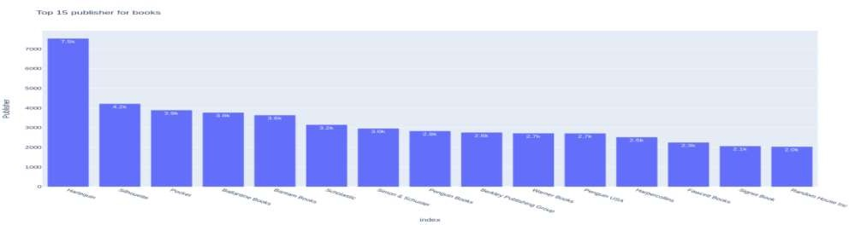
EDA(contd...)
Top 15 publisher of book
Here we se that Harlequin publicatation publish most no of book its almost double than Silhouette which is in 2nd place.

Slide 8
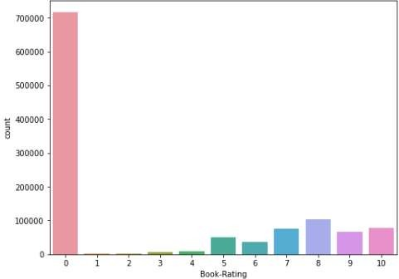
EDA(contd...)
Count vs Book Rating
If we se the rating part most of not given any review here we consider 0.
It almost 50 to 60 percent of our dataset.

Slide 9
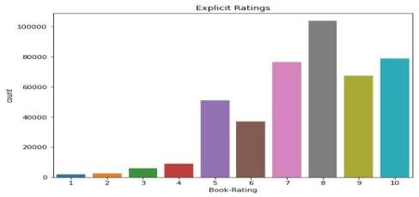
EDA(contd...)
Explicity Rating
If we not consider 0 rating user we se highest no of user given rating 8.
Almost eqal rating given to 7 and 10 then 9.

Slide 10
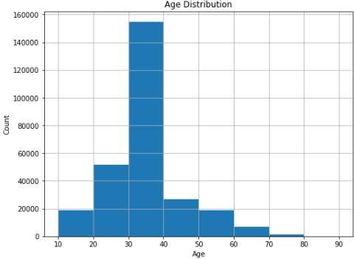
EDA(contd...)
Age Vs Count
Most of the user who rated the mv are from 30-40 yrs age then in 2nd its less than half of that catagory is 20-30

Slide 11
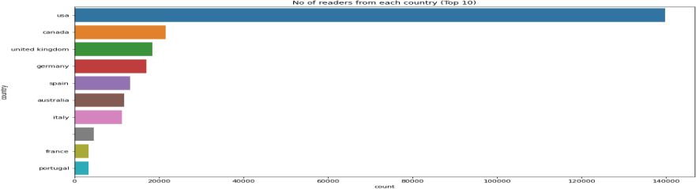
EDA(contd...)
No of readers from each country
Most of the book listed in our daaset are from usa its cover almost 60 to70% of our data

Slide 12
RECOMENTATION SYSTEM
Popularity Based ( Books reviewed by most of the user)
Popular books in country wise
Books popular yr wise
Popular book of same_author
Popular Book of same Publsher
Top most rating books.
Collaborative Filtering (User-Item Filtering)
Content Based filtering

Slide 13
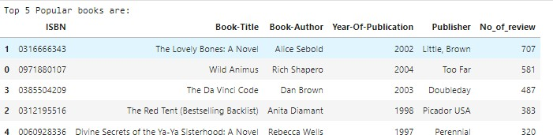
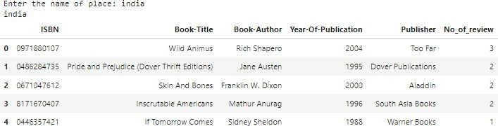
1. Popularity Based ( Books reviewed by most of the user)
2.Popular books in country wise

Slide 14
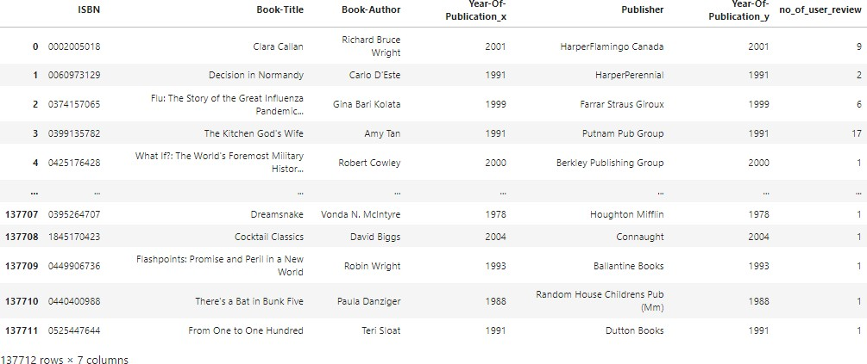
3. Books popular yr wise

Slide 15
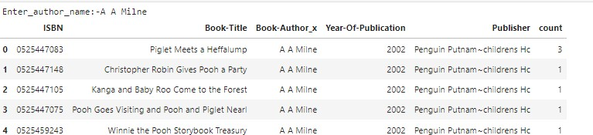
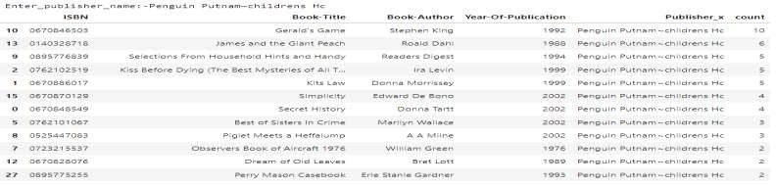
4. Popular book of same_author
5.Popular Book of same Publsher

Slide 16
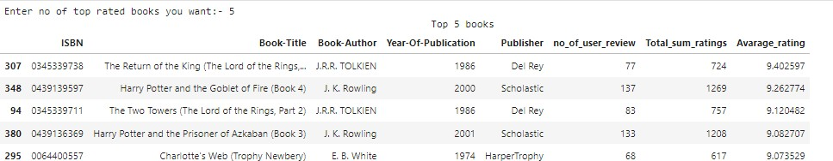
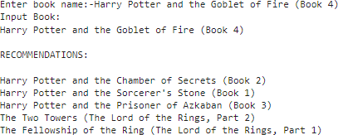
6.Top most rating books.
7. Collaborative Filtering (User-Item Filtering)

Slide 17
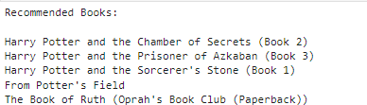
8.Content Based filtering

Slide 18
CHALLENGES
A huge amount of data needed to be dealt while doing the project which is quite an important task and also even small inferences need to be kept in mind Understanding the metric for evaluation was a challenge as well.
Understanding the metric for evaluation was a challenge as well.
Decision making on missing value imputations and
outlier treatment was quite challenging as well.
As dataset was quite big enough which led more computation time.

Slide 19
CONCLUSION
In EDA, the Top-10 most rated books were essentially novels. Books like The Lovely Bone and The Secret Life of Bees were very well perceived.
Majority of the readers were of the age bracket 30-40 and most of them came from NorthAmerican and European countries namely USA, Canada, UK, Germany and Spain. Among them USA have highest no book.
If we look at the ratings distribution, most of the books have high ratings with maximum books being rated 8. Ratings below 5 are few in number.
In book Wild Animus user gives a high no of rating which is 2.5k its so high in compare to other books.
Author with the most books was Agatha Christie, William
Shakespeare and Stephen King.
For modelling, it was observed that for model based collaborative
filtering and content based filtering doing best .
In other aproach the avg rating The Return of the King and hary
poter have most liked books .
●
●
●
●
●
●

Slide 20
THANK YOU

